Slide 1



Week 13 LLAB
C/Lt Col Vallor and C/2d Lt Al Luhaibat
Air Force ROTC Detachment 842
The University of Texas at San Antonio

Slide 2


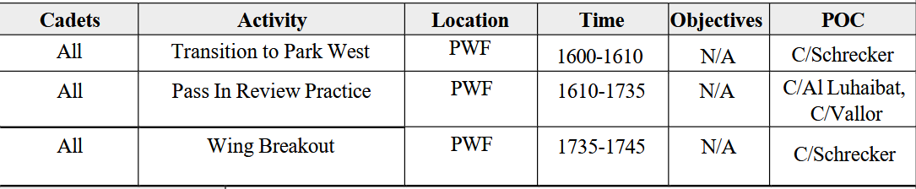
Overview
Parking
Pass In Review Practice
Air Force ROTC Detachment 842 • We Build Exceptional Officers • The University of Texas at San Antonio

Slide 3
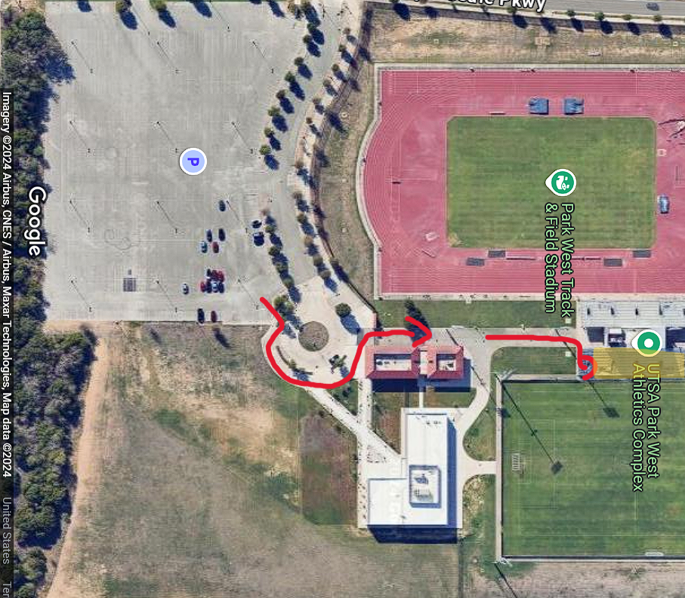
Parking
ALL CADETS MUST BE AT PARK WEST NLT 1600
Due to limited spots, please carpool!
After parking, follow this diagram to get to the field
Location Address: 8000 TX-1604 Loop, San Antonio, TX 78249
PARK
Air Force ROTC Detachment 842 • We Build Exceptional Officers • The University of Texas at San Antonio

Slide 4
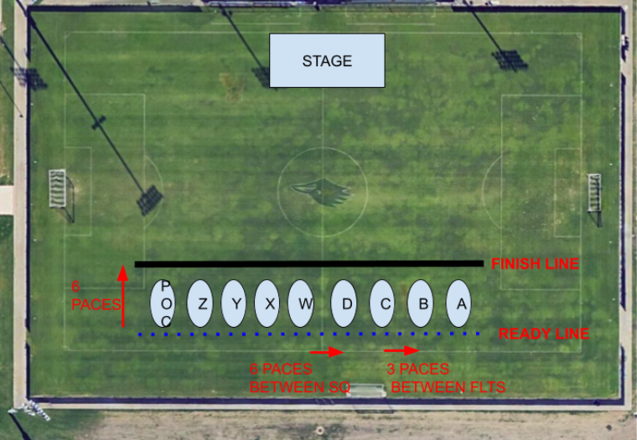
Pass In Review Practice
The Wing will organize according to this figure
We will have two water breaks:
Break 1: 1630
Break 2: 1700
Air Force ROTC Detachment 842 • We Build Exceptional Officers • The University of Texas at San Antonio

Slide 5
Equipment
Item | Quantity
Signs | TBD
Pumpkins | 2
Cups | 2 packs
Water Bottles | 1 Package (for cadre + guests)
Microphone | 2
Speakers | 2
Cones | 9
Canopies | 2
Air Force ROTC Detachment 842 • We Build Exceptional Officers • The University of Texas at San Antonio

Slide 6
Summary
Parking
Pass In Review Practice
Air Force ROTC Detachment 842 • We Build Exceptional Officers • The University of Texas at San Antonio

Slide 7
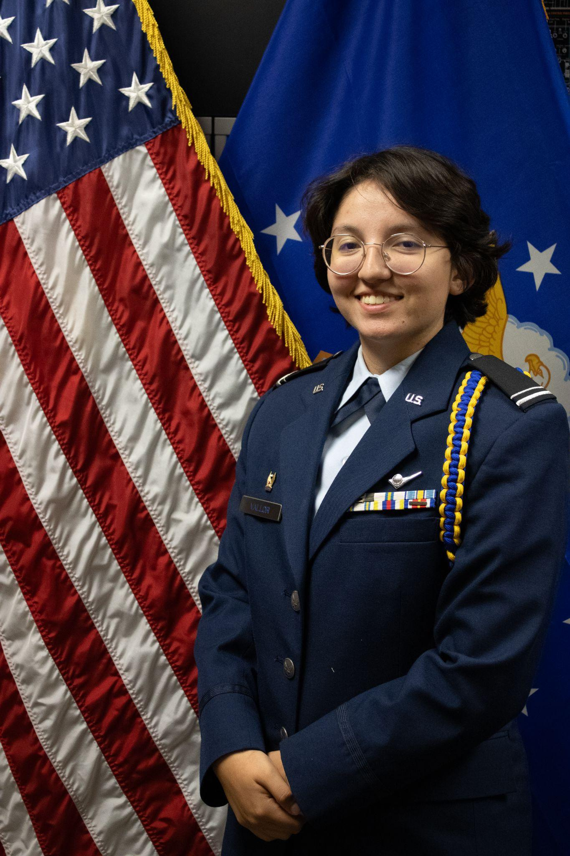
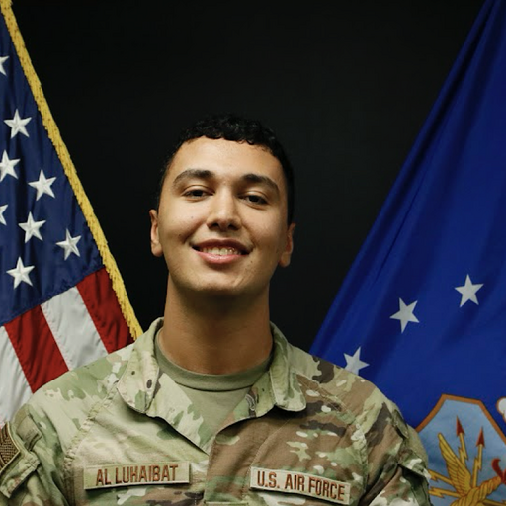
Questions?
C/Lt Col Vallor
Deputy Commander of Operations
mary.vallor@my.utsa.edu
210.913.5497
C/2d Lt Al Luhaibat
LLAB Execution Officer
taha.alluhaibat@my.utsa.edu
830.765.7359
Air Force ROTC Detachment 842 • We Build Exceptional Officers • The University of Texas at San Antonio

